Slide 1

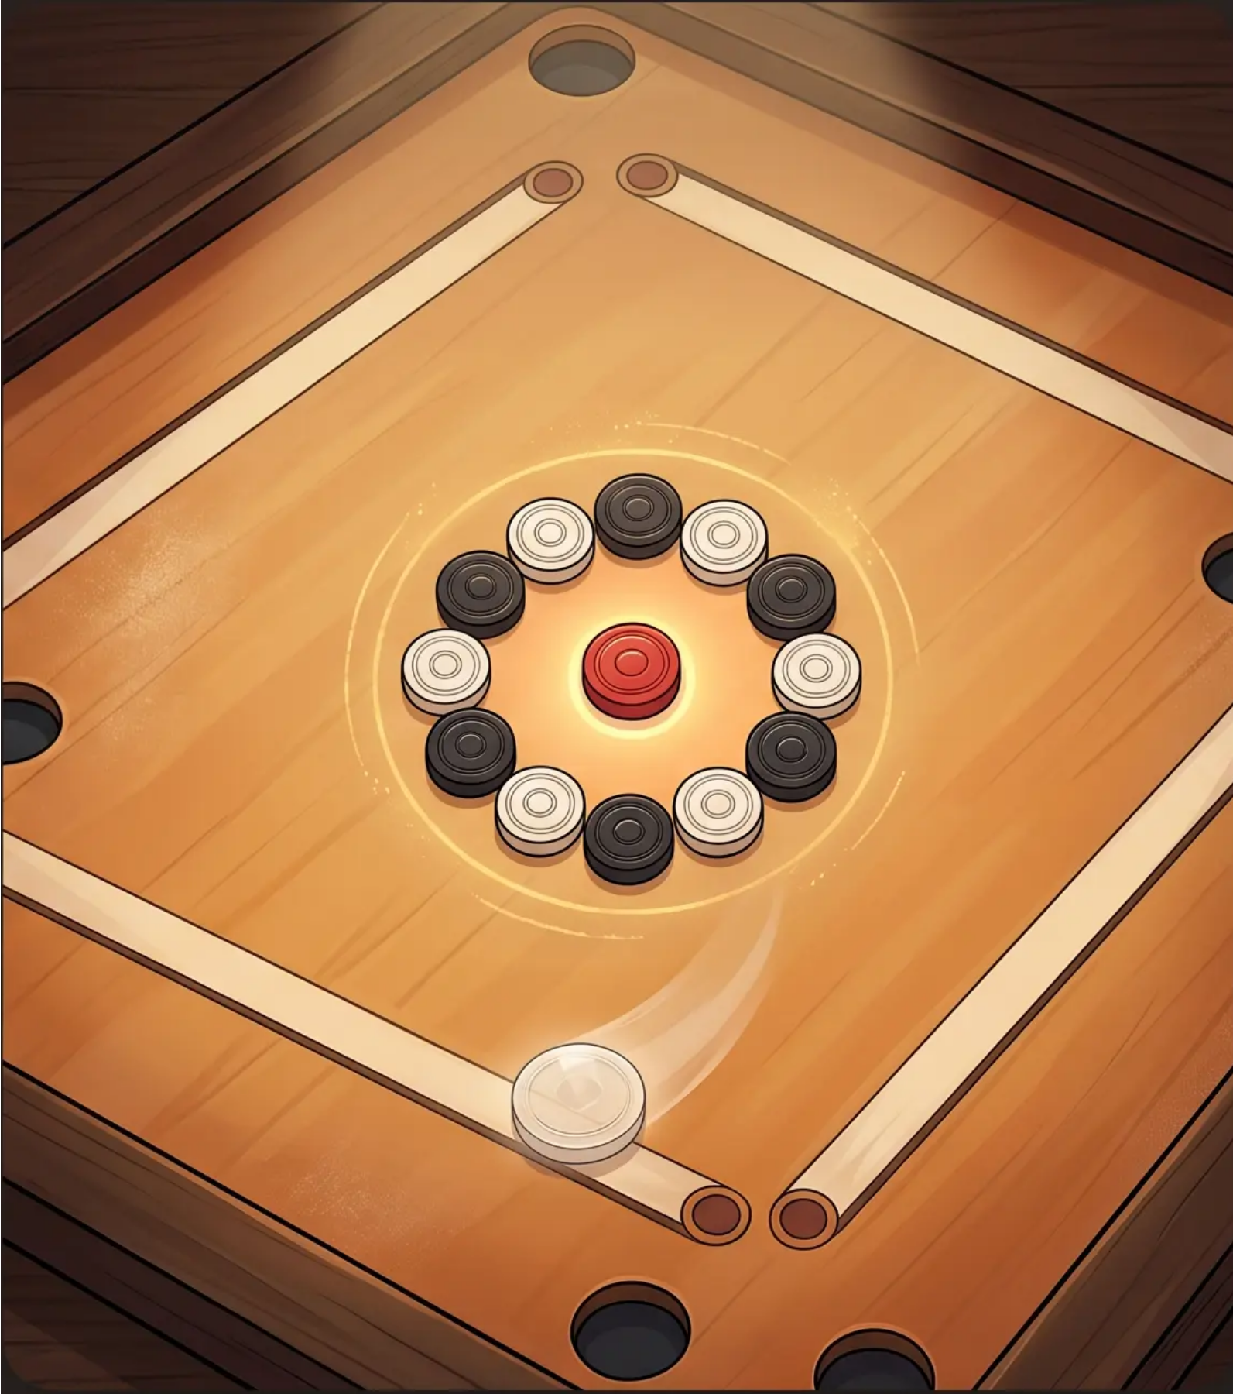




Carrom Board Game
Rules • Gameplay • Scoring
THE BOARD & PIECES
29" square board · 9 white · 9 black · 1 Red Queen · 1 Striker
THE BREAK & STRIKING RULES
Flick the striker from the baseline · Pocket your color · Take extra turns
COVERING THE QUEEN
Pocket the Queen · Follow with your piece · Worth 3 points
ICF SCORING • COMMON FOULS
First to 25 points wins · Scratch = lose a turn + return a piece
*International Carrom Federation (ICF) Standards

